Slide 1
Asia The Continent Series
VMS Library 2008-2009

Slide 2
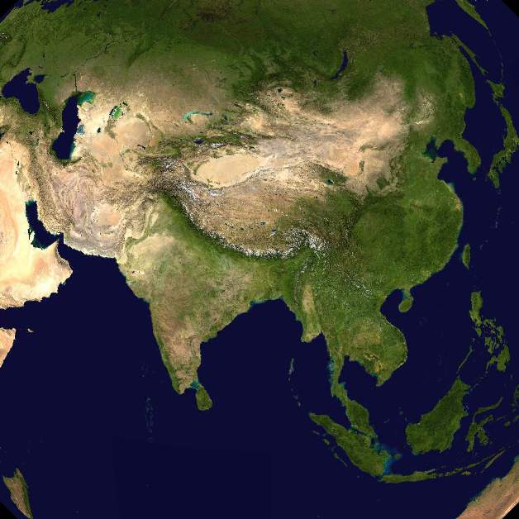
Satellite View

Slide 3
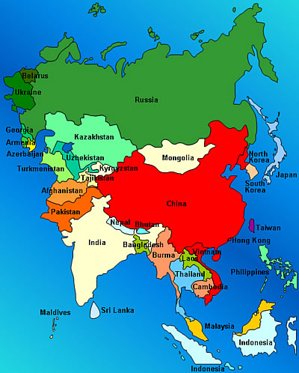
Map of Asia

Slide 4
Longitude / Latitude

Slide 5
Unique qualities
Largest continent
30% of the earth’s surface
Over 4 billion in population

Slide 6
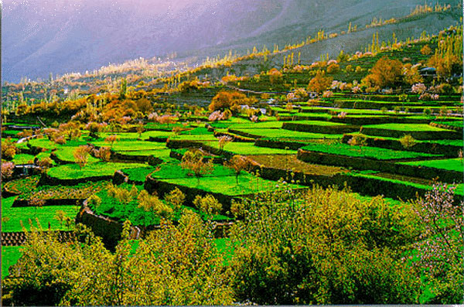
Terraced Hills in Asia

Slide 7
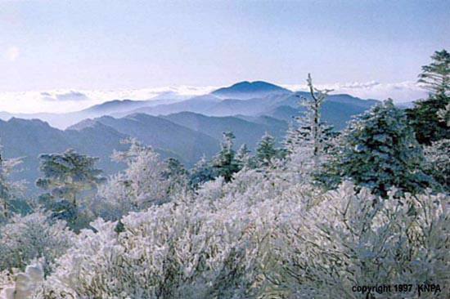
Mountains in Asia

Slide 8
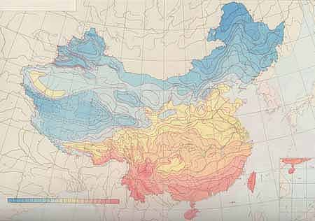
Climate Map - January
Blue is -8° F
Red is 75° F

Slide 9
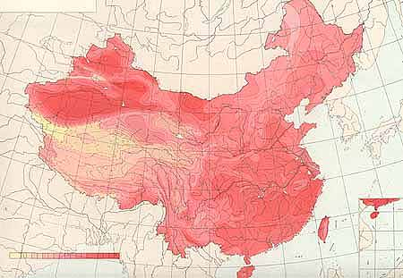
Climate map - July
Dark red is 104°F
Yellow is 46°F

Slide 10
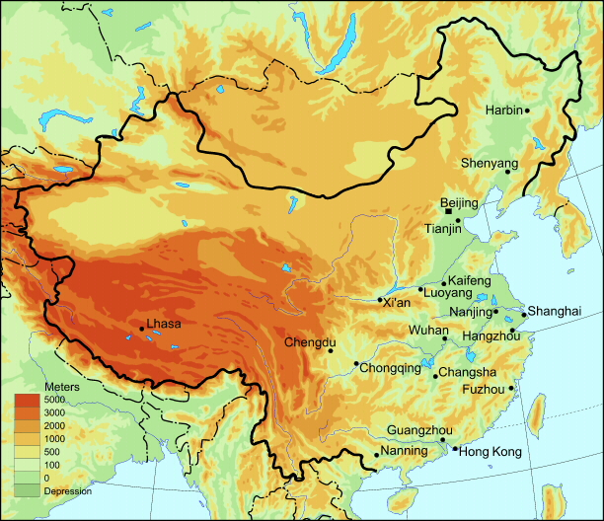
Contemporary Cities

Slide 11
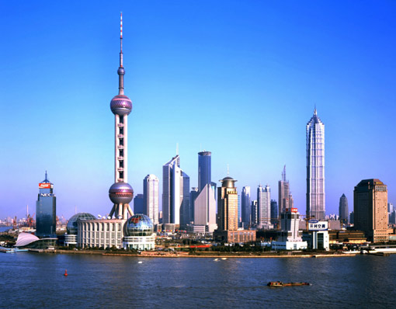
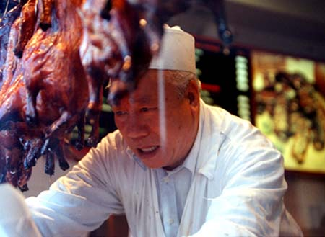
Shanghai Skyline & Street Merchant

Slide 12
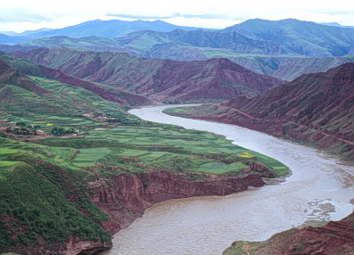
Yellow River – Western China
3398 miles long

Slide 13
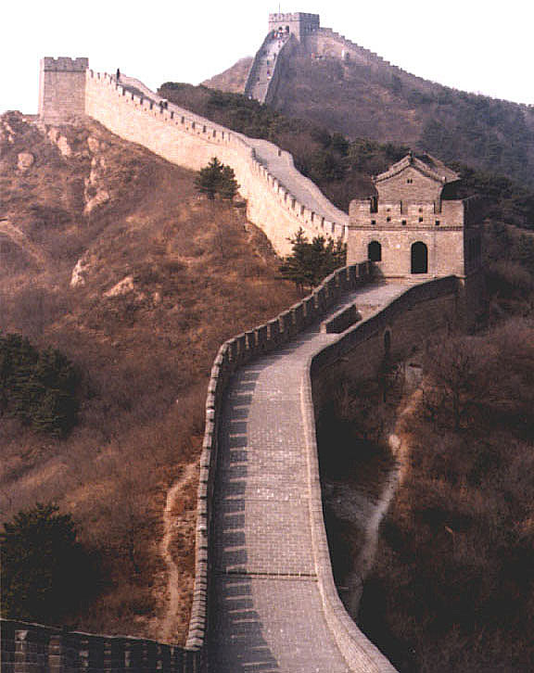
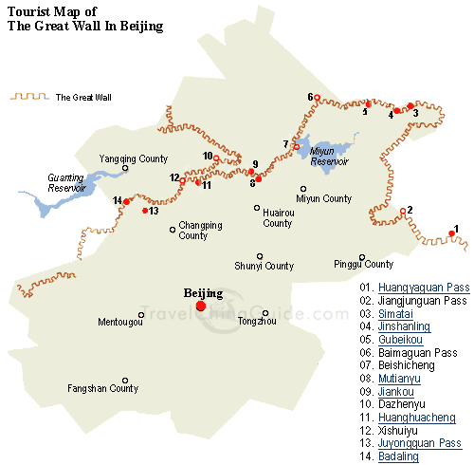
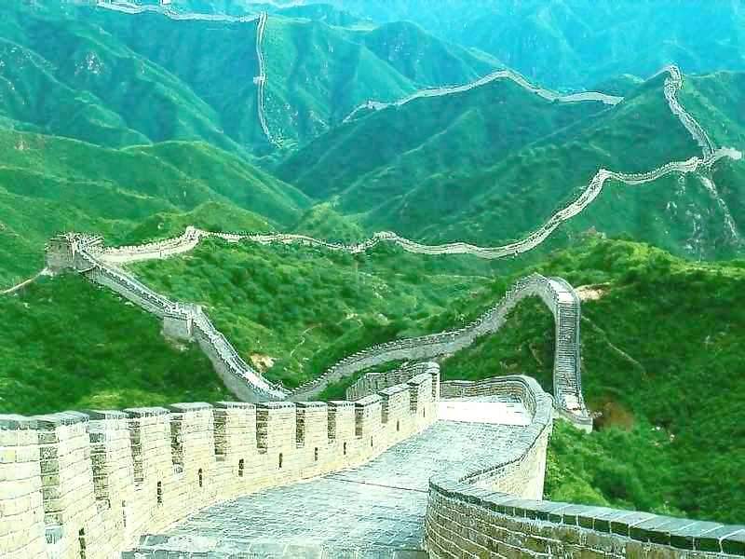
The Great Wall
4,000 miles long
30 feet wide

Slide 14
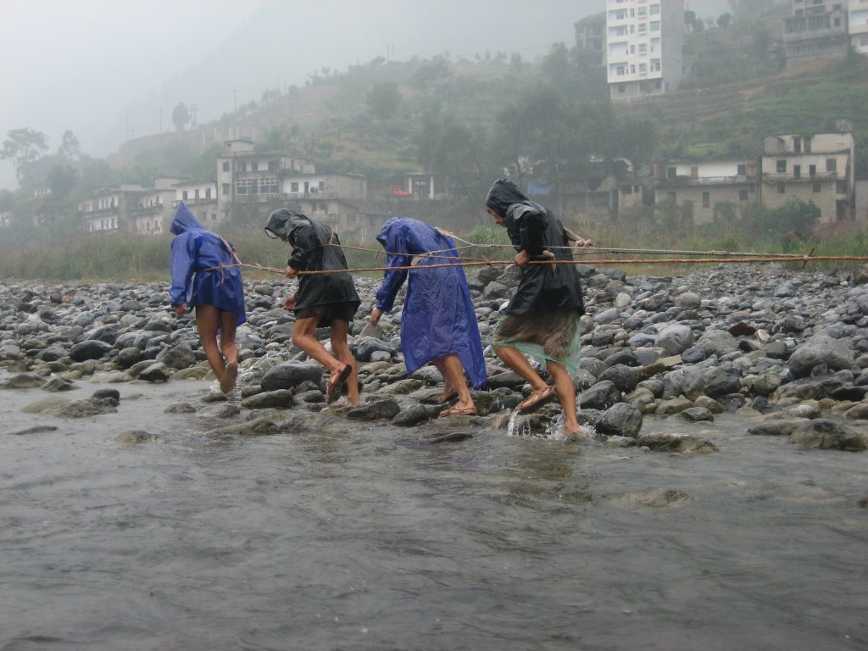
Trackers on the Yantzee River

Slide 15
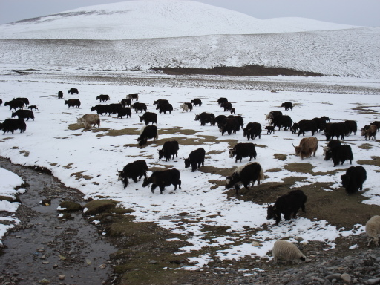
Yaks in Tibet – Central Asia

Slide 16
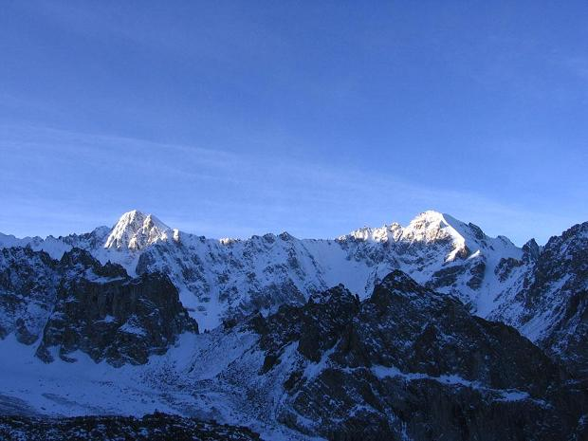
Mountains in Central Asia

Slide 17
Gobi Desert – Northern China
Asia is home to 3 of the world’s largest cold deserts
Chang Tang, on the Plateau of Tibet in China
Taklimakan Desert
Gobi (Mongolian for "waterless place")

Slide 18
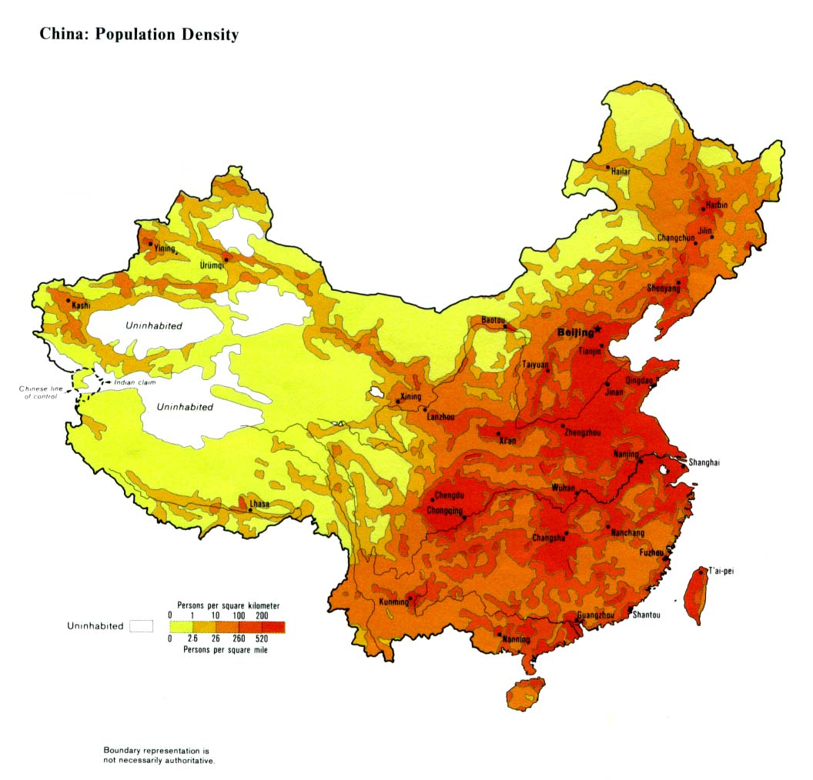
Population Map
Red = 520 people per sq mile
Yellow = 2.6 people per sq mile

Slide 19
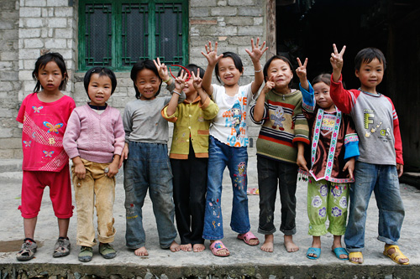
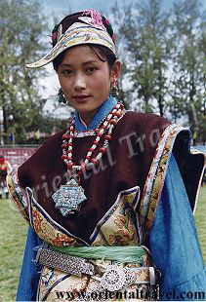
Han Chinese 92% of the population

Slide 20
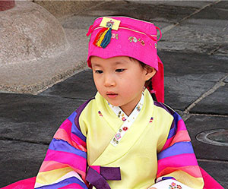
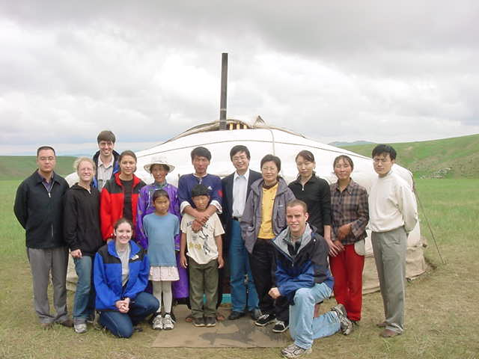
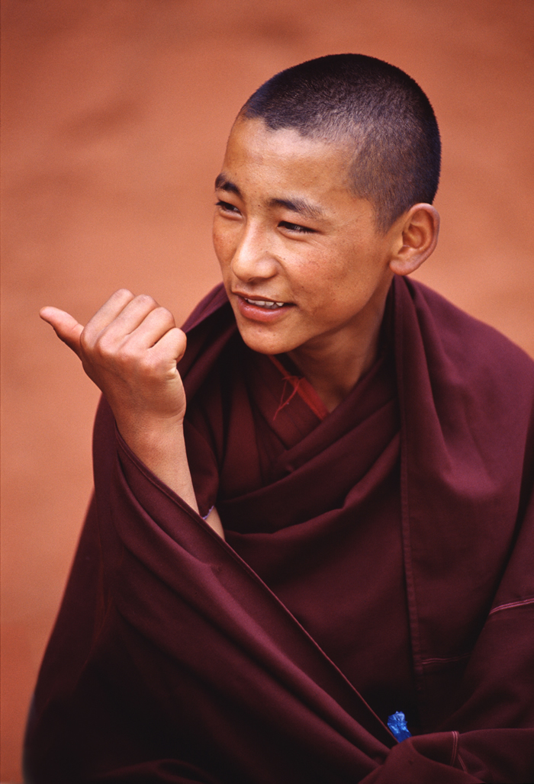
55 cultures make up 8% of the population
Korean Mongol family Tibetan

Slide 21
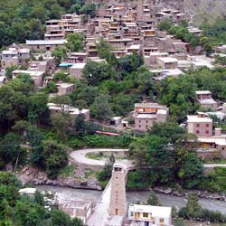
Qiang Village

Slide 22
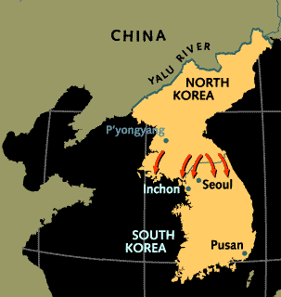
Korea

Slide 23
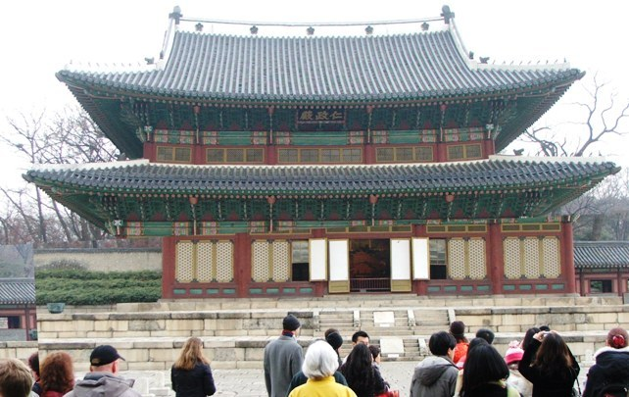
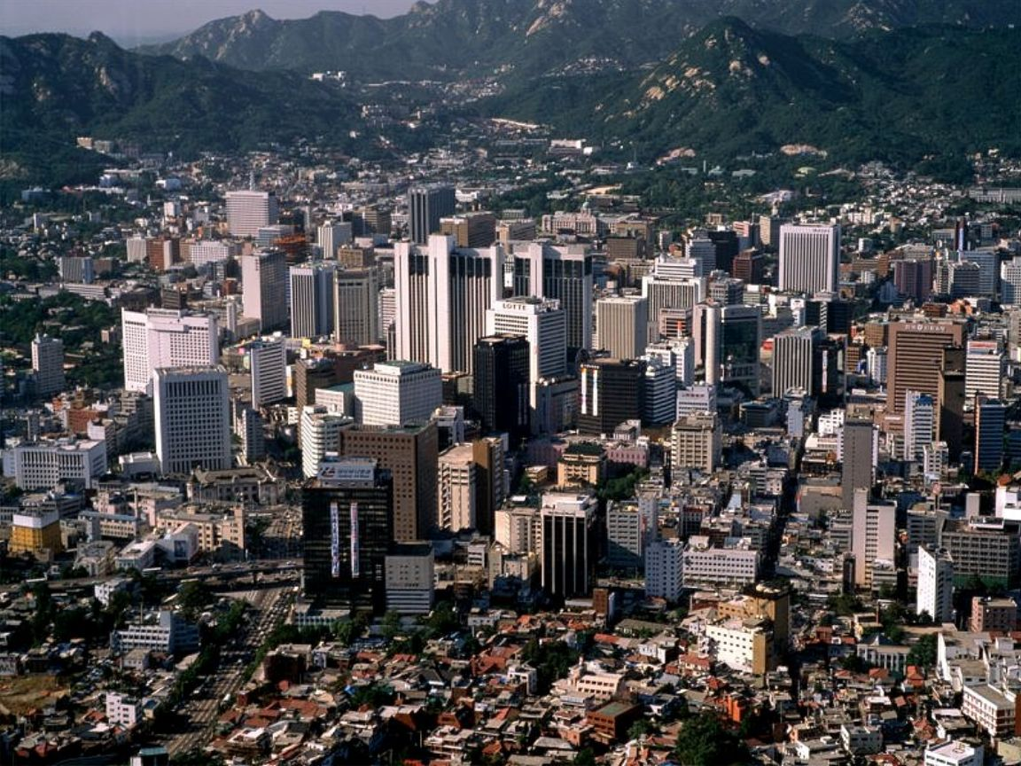
Seoul South Korea
Seoul Today
Changdeok Palace

Slide 24
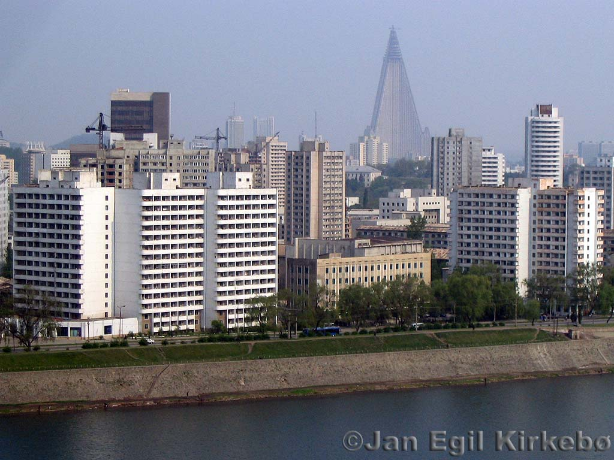
Pyongyan North Korea

Slide 25
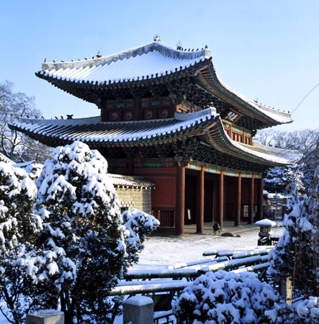
Weather in Korea

Slide 26
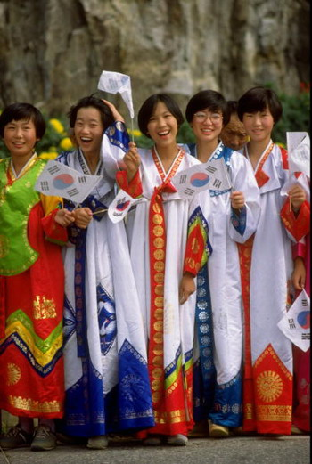
Traditional Dress in Korea

Slide 27
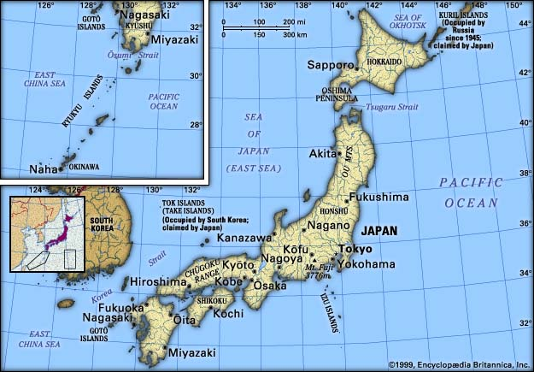
Japan

Slide 28
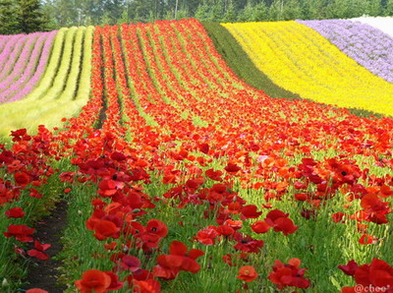
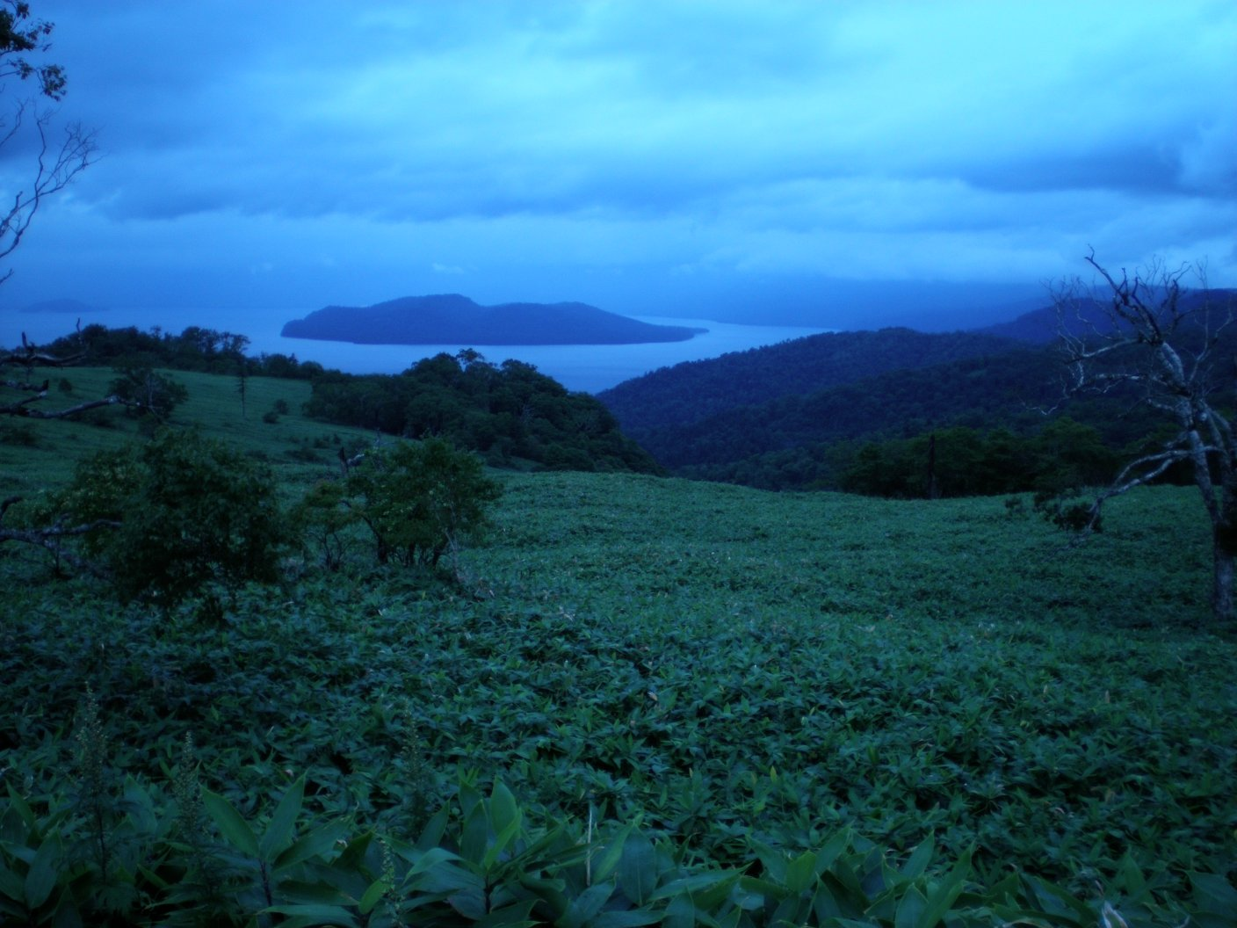
Hokkaido – Northern most point

Slide 29
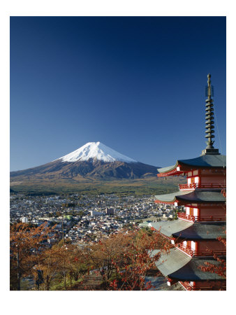
Honshu – Central Japan

Slide 30
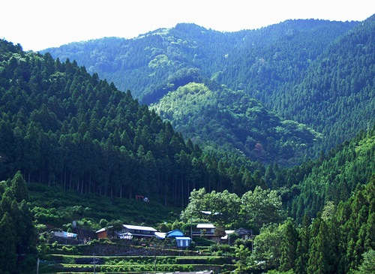
Shikoku – Southern Japan

Slide 31
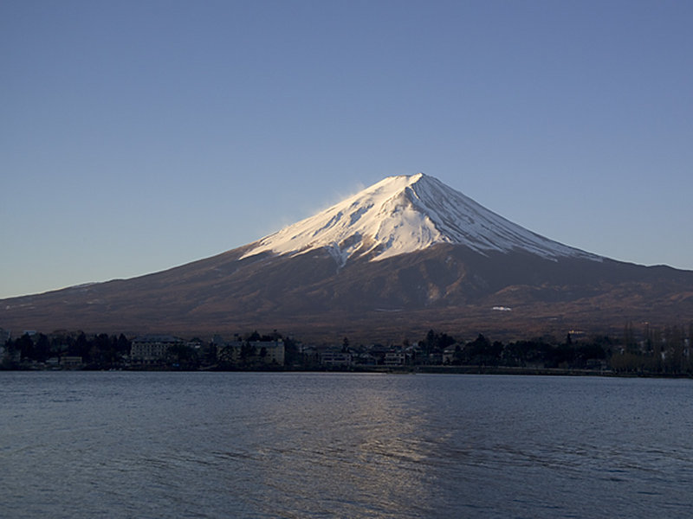
Mount Fuji – 12,338 feet high

Slide 32
This powerpoint was kindly donated to www.worldofteaching.com
http://www.worldofteaching.com is home to over a thousand powerpoints submitted by teachers. This is a completely free site and requires no registration. Please visit and I hope it will help in your teaching.

